Slide 1
GROUP MENTORING
SERGIO
GROUP - B4
15.06.2020

Slide 2
GROUP - B4
E2014 Devin
E2128 Uğur
E2151 Fırat
E2174 Durmus
E2252 Hayati Yusuf
E2263 Ramazan Rafet
E2332 Adem
E2366 Vedat

Slide 3
GÜNDEM
- Grup İsmi
- One-on-One Meeting için Calendly’den Randevu Alınması
- Path tercihlerinin Bildirilmesi
- HTML ve CSS
- AGILE
- Jira Software Kurulumu
- Python
- Linux

Slide 4
GRUP İSMİ
BAGER

Slide 5
ONE-on-ONE MEETING
https://calendly.com/sergio_taco

Slide 6
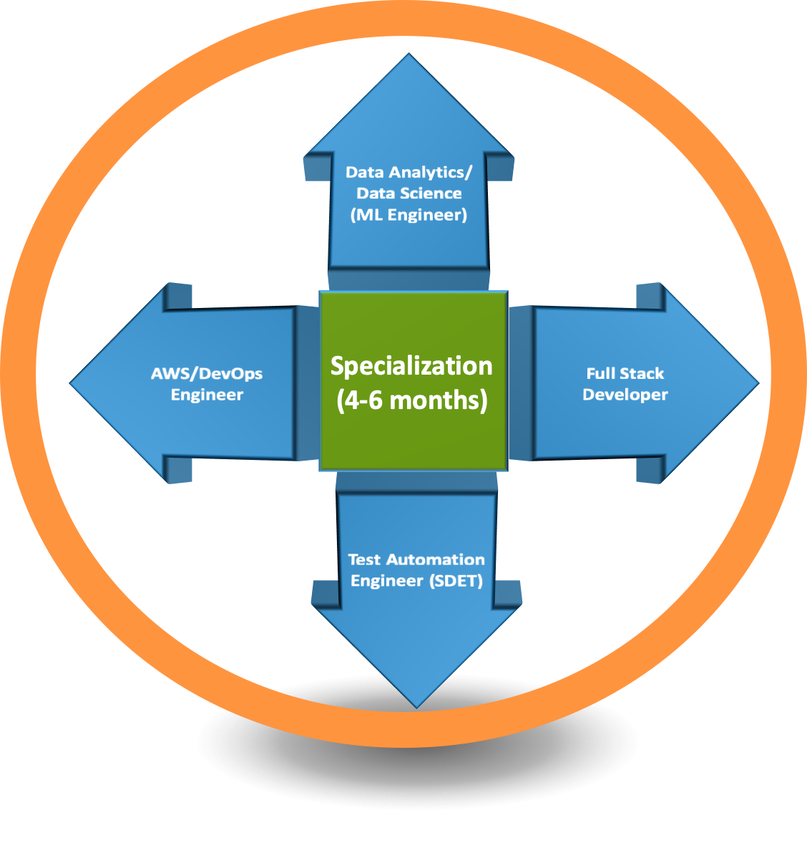
PATH TERCİHLERİNİN İLETİLMESİ
16 HAZİRAN 2016
15.00

Slide 7
HTML ve CSS
- Assignments
- Pre-Class Material
- Workshop
- Lab
- Quiz

Slide 8
SDLC
1. REQUIREMENT PHASE :The first and the most critical phase. In this phase;
The client specifies requirements, specifications, expectations and any other special requirement related to the product or software.
The business manager or project manager gathers all of this information and also prerequisites.
Once all the information gathered, the next step is to clearly define and document the product requirements and get them approved by the customer or the market analysts.
This is done through an SRS (Software Requirement Specification) document. It consists of all the necessary requirements to be designed and developed during the project life cycle.

Slide 9
SDLC
2. DESIGN PHASE: In this phase, the requirement gathered in the SRS document is used as an input and software architecture that is used for implementing system development is derived.
This is the high priority phase in a system's development life cycle because the logical designing of the system is converted into physical designing.
The output of the requirement phase is a list of things that are required and the design phase gives the way to accomplish these requirements.
The decision of all required essential tools such as programming language like Java, .NET, PHP; database like Oracle, MySQL; a combination of hardware and software to provide a platform on which software can run without any problem is taken in this phase.
There are several tools and techniques used for describing system design, such as Flowchart, Data flow diagram (DFD), Data dictionary, Structured English, Decision table, and Decision tree.

Slide 10
SDLC
3. BUILD/DEVELOPMENT PHASE: After the successful completion of the requirement and design phase, the next step is to implement the design into the development of a software system.
This phase is also known as coding phase.
Developers start to build the entire system by writing code using the chosen programming language.
Work/task is divided into small units or modules, and coding starts by the team of developers according to the design and the requirements of the client to produce the desired result.
Coding Phase is the longest phase of the SDLC process, and it requires a more focused approach for the developer.

Slide 11
SDLC
4. TESTING PHASE: This phase is where you focus on investigation and discovery.
The testing team starts testing the functionality of the entire system. This is done to verify that the software works and gives the result as per the requirements addressed in the requirement phase or not.
The development team makes a test plan to start the test. This test plan includes all types of essential testing such as integration testing, unit testing, acceptance testing, and system testing.
If there is a bug/defect detected in the software, or it is not working as expected. The testing team gives detailed information to the development team about the issue. If the defect is valid or worth fixing, it will be fixed and the development team replaces it with the new one. It also needs to be verified.

Slide 12
SDLC
5. DEPLOYMENT/DELIVER PHASE: When software testing is completed with a satisfying result and there are no remaining issues in the working of the software, it is delivered to the customer.
As soon as customers receive the product, they are recommended first to do the beta testing. In beta testing, customers can require any changes which are not present in the software but mentioned in the requirement document to make it more user-friendly.
Besides this, if any type of defect is encountered while a customer using the software, the development team will be informed to fix this problem. If it is a critical defect, the development team solves it in a short time. Otherwise, it will wait for the next version.
After the solution of all types of bugs and changes, the software finally deployed to the end-user.

Slide 13
SDLC
6. MAINTENANCE PHASE: The last phase of the process SDLC is the maintenance phase where the process continues until the software's life cycle comes to an end. When a customer starts using software, actual problems start to show up. At that time, there's a need to solve these problems.
Maintenance Phase also includes making changes in hardware and software to maintain its operational effectiveness like to improve its performance, enhance security features and address customer's requirements.

Slide 14
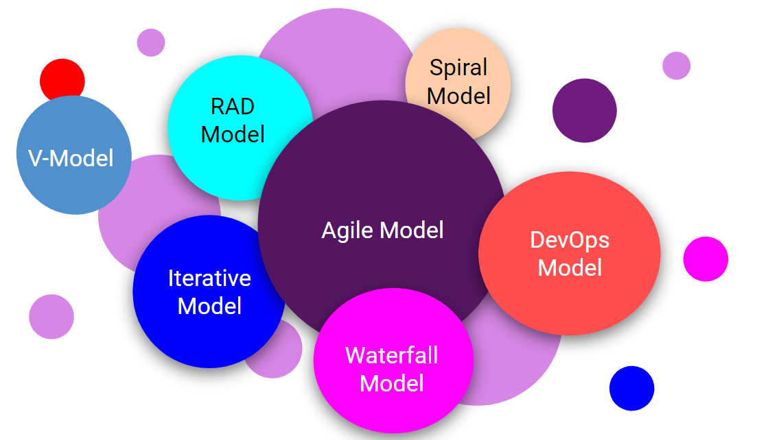
SDLC MODELS

Slide 15
SDLC MODELS
WATERFALL MODEL
ITERATIVE MODEL
SPIRAL MODEL
V-MODEL
RAD MODEL
AGILE MODEL
DEVOPS MODEL

Slide 16
AGILE
AGILE NEDİR : Software projects face the risk of failure during the life cycle due to misuse of resources, wrong prioritization and inaccurate understanding of customer demands. This has led companies to experiment with a variety of new methods to produce more productive projects.
Agile is a new approach to project management methods resulting from these experiments. This method is based on an incremental and iterative approach that helps teams deliver a product to their customers faster and more desirable.
In this respect, the framework of agile promises significant advantages over traditional methods. In recent years, most companies have adopted the agile approach, which they find more successful than traditional methods.
In this context, we can say that almost every software developer has used the agile method in some form.

Slide 17

AGILE
Dividing Product Development Life Cycle into Small Components
Agile provides a light framework for development teams. That helps them focus on fast delivery while maintaining functionality. In Agile, the product development life cycle is divided into small components (called iterations), so the product can be easily and rapidly developed and tested. In this way, changes can be made without having to wait for the final product.

Slide 18
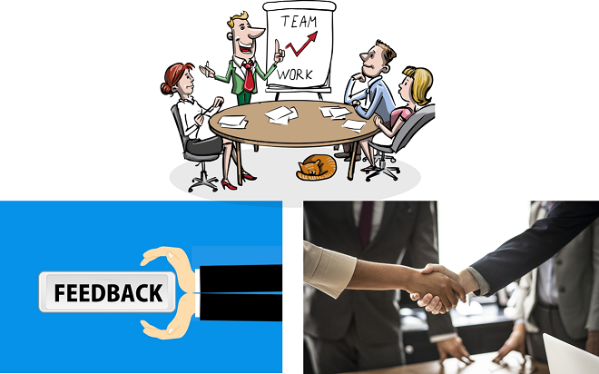
AGILE
Customer's Desired Requirements
The agile method provides that the product is optimized throughout the development process. Using iterative planning and getting feedback ensures that a delivered product is tailored to the customer's requirements. The status of the project is measured and evaluated throughout the process to easily adapt to changing needs. Measurement and evaluation provide accurate and early visibility into the development of each project.

Slide 19
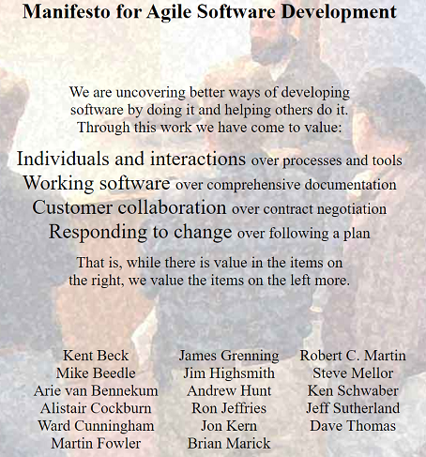
AGILE
1. Individuals and interactions over processes and tools.
2. Working software over comprehensive documentation.
3. Customer collaboration over contract negotiation.
4. Responding to change over following a plan.

Slide 20
AGILE
Agile Principles
In the months following the publication of the Agile Manifesto, the original signatories continued to communicate. They augmented the four values of the manifesto with the following 12 principles.
Our highest priority is to satisfy the customer through early and continuous delivery of valuable software.
Welcome changing requirements, even late in development. Agile processes harness change for the customer’s competitive advantage.
Deliver working software frequently, from a couple of weeks to a couple of months, with preference to the shorter timescale.
Business people and developers must work together daily throughout the project.
Build projects around motivated individuals. Give them the environment and support they need, and trust them to get the job done.
The most efficient and effective method of conveying information to and within a development team is face to face conversation

Slide 21
AGILE
Agile Principles
7. Working software is the primary measure of progress.
8. Agile processes promote sustainable development. The sponsors, developers, and users should be able to maintain a constant pace indefinitely.
9. Continuous attention to technical excellence and good design enhances agility.
10. Simplicity -the art of maximizing the amount of work not done- is essential.
11. The best architectures, requirements, and designs emerge from self-organizing teams.
12. At regular intervals, the team reflects on how to become more effective, then tunes and adjusts its behavior accordingly.

Slide 22
Scrum

Slide 23

Table of Contents
Sprint Concept
Scrum Roles
Epic, User Story and Task
Scrum Artifacts
Scrum Ceremonies

Slide 24
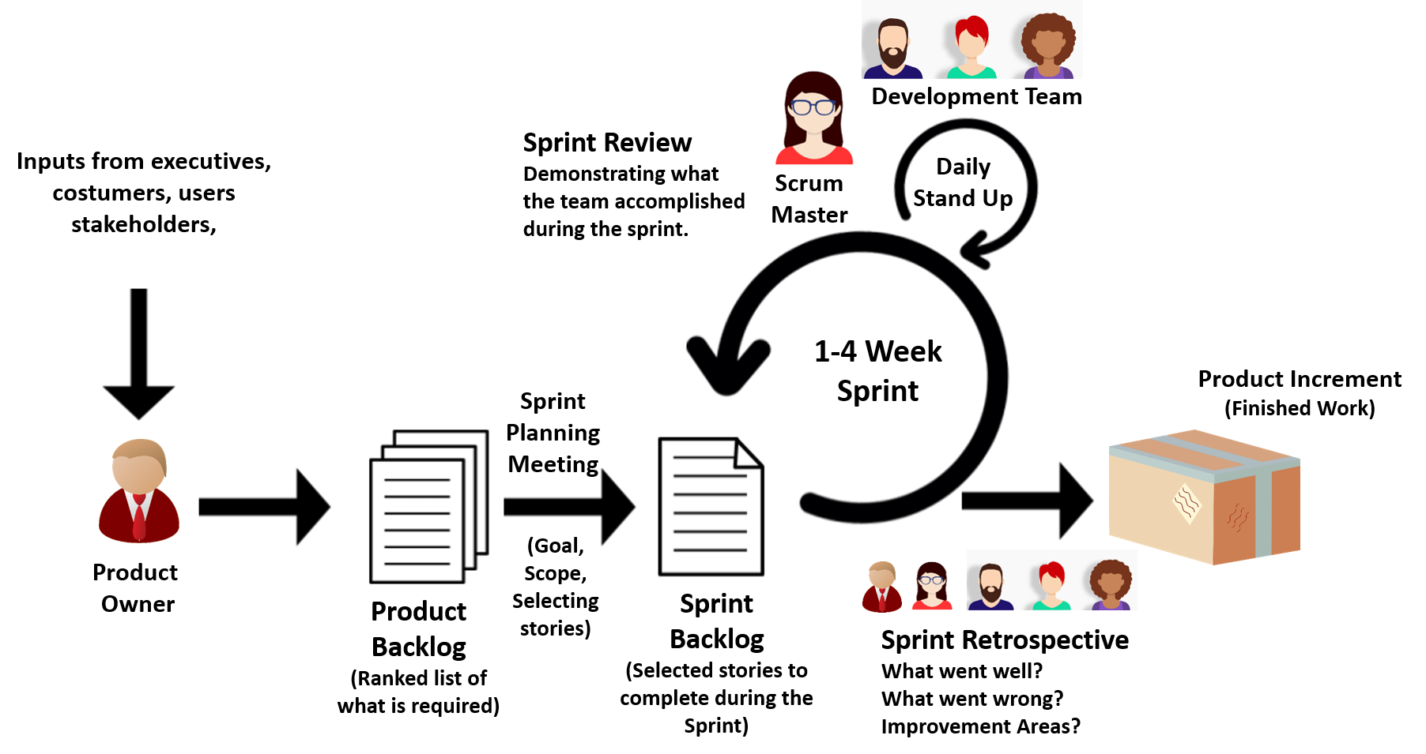
Sprint Concept
The Scrum Framework

Slide 25
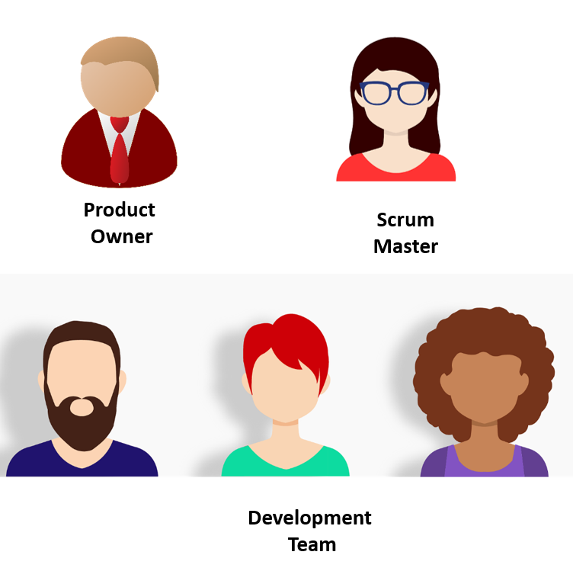
Scrum Roles

Slide 26
Product Owner
Business representative
Represents stakeholders
Voice of the customer
Works together with stakeholders
Prioritizes the product backlog

Slide 27
Scrum Master
Coaches the team
Clears any obstacles encountered
Helps team members focus on what they do
Ensures that the team is working properly

Slide 28
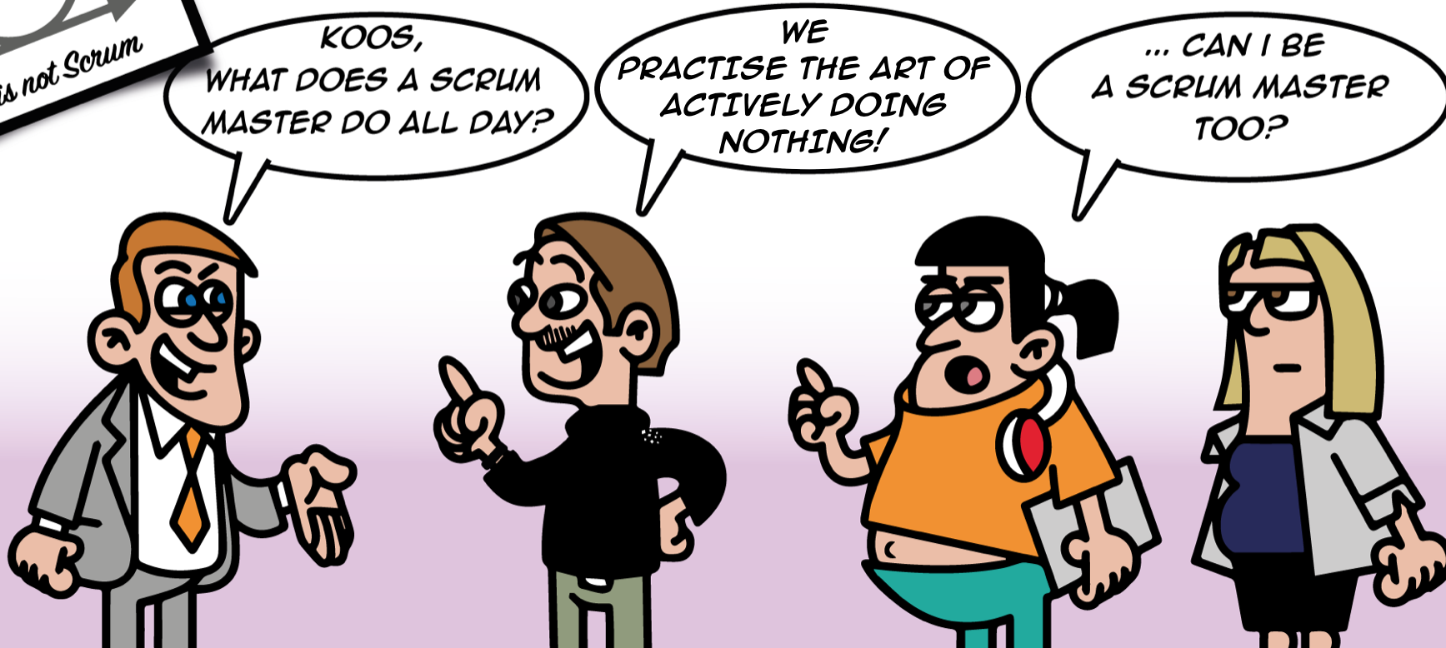
Scrum Master

Slide 29
Development Team
Consists of 3-9 people
Performs daily tasks

Slide 30
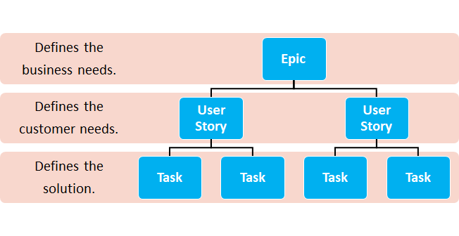
Epic, User Story and Task

Slide 31
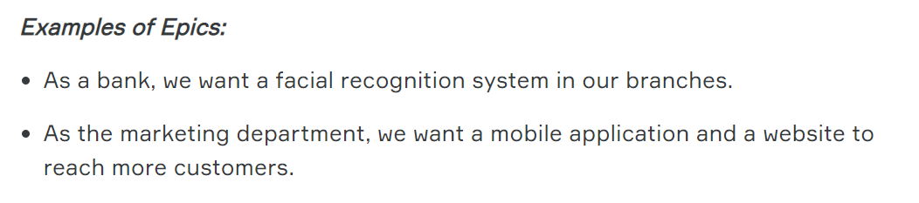
Epic
A set of jobs that cannot be easily achieved in a single sprint.

Slide 32
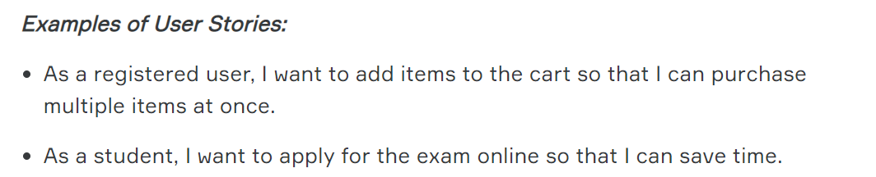
User Story
Describes a software feature from the customer’s perspective
Includes the “type of user”, “what they want”, and “why they want it”.

Slide 33
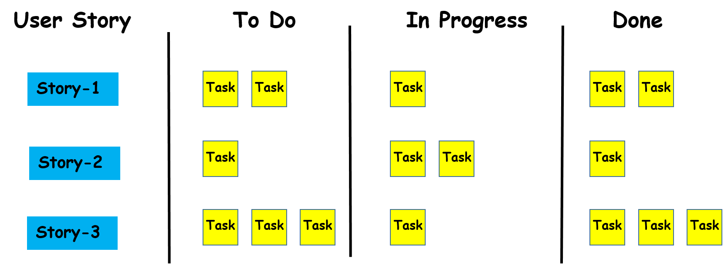
Scrum Board
Manual or electronic

Slide 34
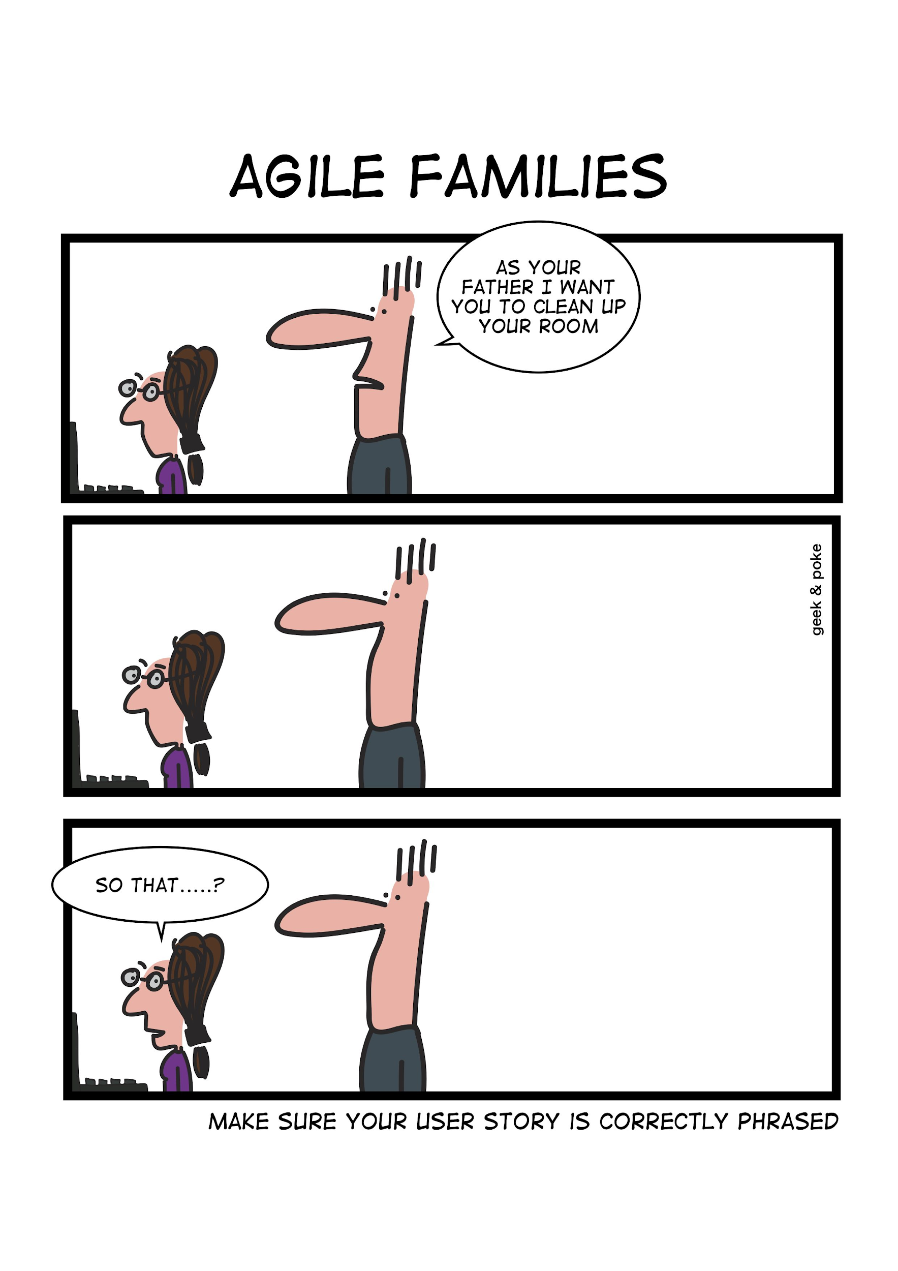
User Story

Slide 35
Tasks
Detailed pieces of work that are necessary to realize a user story.
Define the solutions for customer needs.

Slide 36
Epic, User Story and Task
What do you think?
Which one maybe NOT appropriate?
Categorize the following events as Epic, User Story or Task:
Making a Website
Creating a homepage for the website
Making a button for the homepage.
Notes:
🍐 This is a Pear Deck Multiple Choice Slide. Your current options are: A: Making a Website : Epic, B: Creating a homepage for the website : User Story, C: Making a button for the home page : Task, D: Making a Website : Task,
🍐 To edit the type of question or choices, go back to the "Ask Students a Question" in the Pear Deck sidebar.

Slide 37
Main Scrum Artifacts
3
1
2

Slide 38
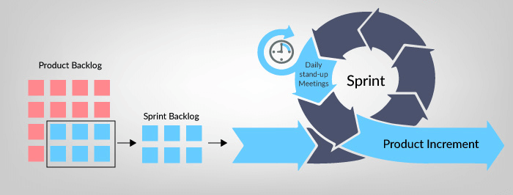
Product Backlog
List of everything to complete the project
Beside all user stories, includes technical tasks

Slide 39
Sprint Backlog
A subset of the product backlog.
Not flexible, unchanged during the sprint period.

Slide 40
Product Increment
Sum of all the product backlog items finished during the sprint

Slide 41
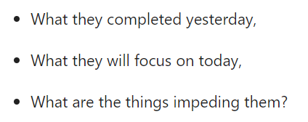
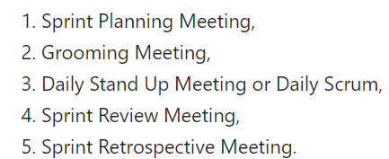
Scrum Ceremonies

Slide 42
Sprint Planning Meeting
“Decide the scope and select the
user stories from
Product Backlog”

Slide 43
Grooming Meeting
“Review the Backlog, delete or add items”

Slide 44
Daily Stand Up Meeting
“15 minutes”

Slide 45
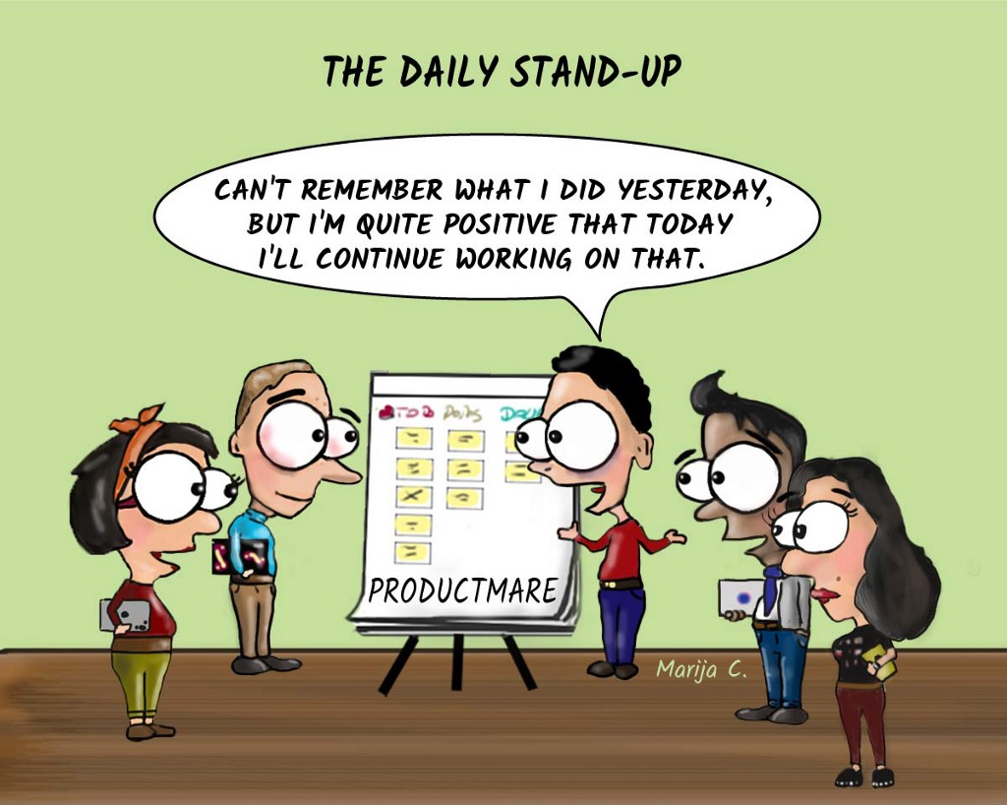
Daily Stand Up Meeting

Slide 46
Sprint Review Meeting
“Get Feedback”

Slide 47
Sprint Retrospective Meeting
“Effective solutions to problems”

Slide 48
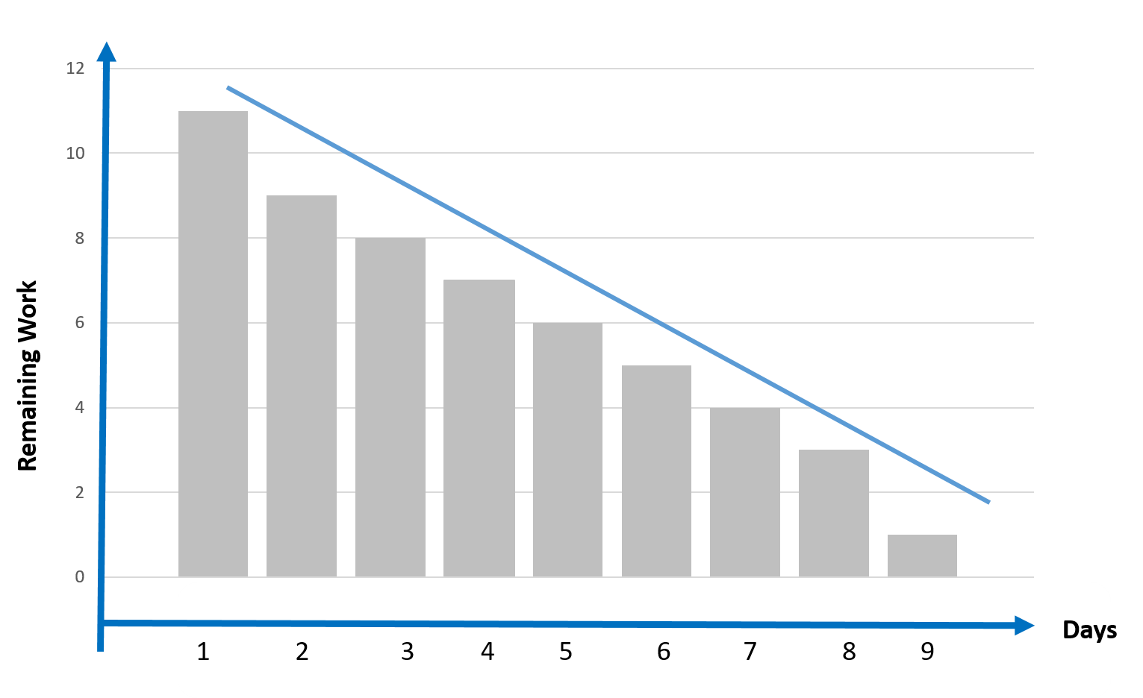
Burndown Chart
Graphical demonstration of remaining work versus time.

Slide 49

Timeboxing
A timebox is a period of time in which a team works to achieve a goal.
Instead of waiting until the goal is reached, the timeboxing approach STOPS when the time limit is reached.

Slide 50
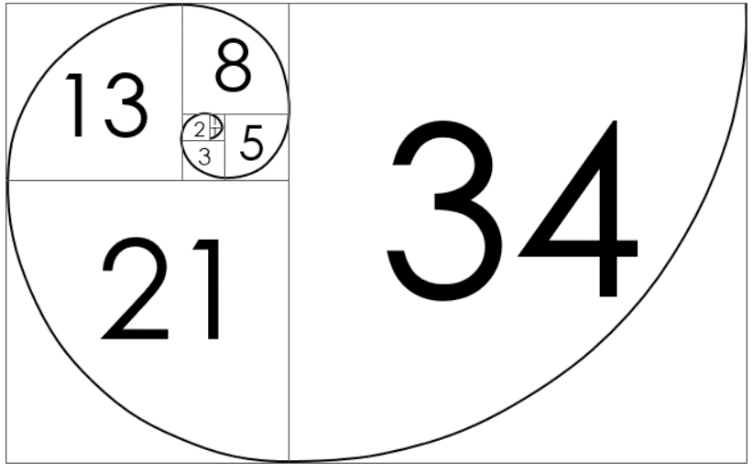
Story Points
- Numeric values that indicate the difficulty level of the user stories
- Assigned to each user story using the Fibonacci numbers

Slide 51
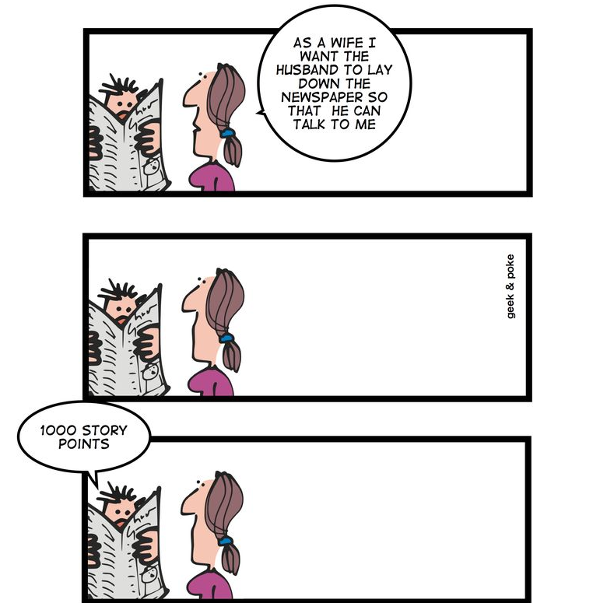
Story Points
Story point describes the difficulty level !

Slide 52
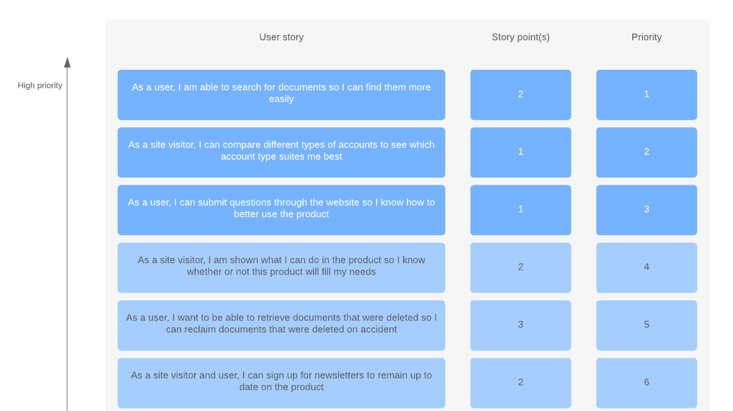
Story Points in a Product Backlog

Slide 53
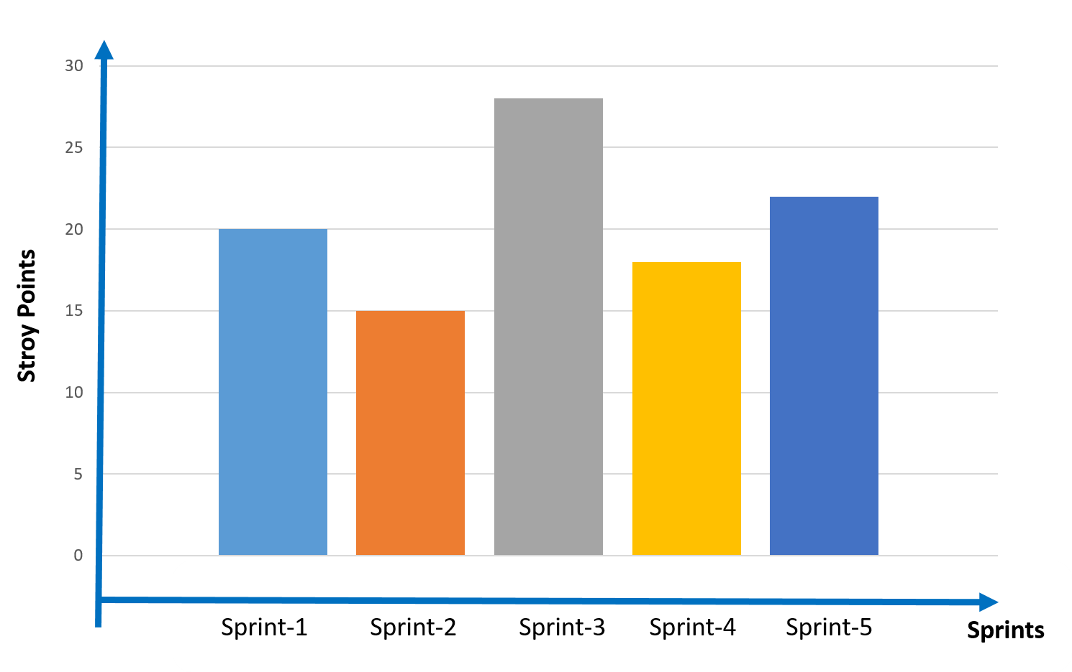
Velocity
- Key metric in scrum
- Summing up all story points at the end of each sprint
- Making an estimation of how long the project will take to complete.

Slide 54
Velocity
What do you think?
Notes:
🍐 This is a Pear Deck Multiple Choice Slide. Your current options are: A: The velocity is the highest in the Sprint-3, B: Sprint-3 must be the longest sprint.,
🍐 To edit the type of question or choices, go back to the "Ask Students a Question" in the Pear Deck sidebar.

Slide 55
JIRA
DERS NOTLARI

Slide 56
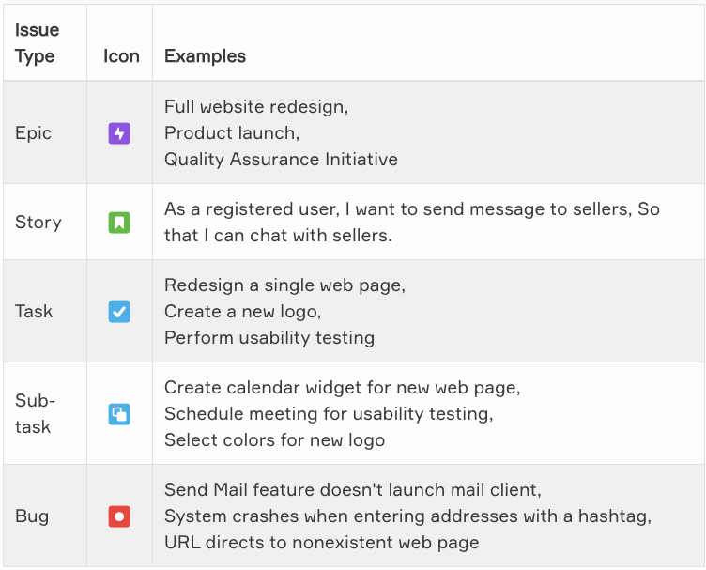

QUESTIONS

Slide 57
QUESTIONS
What is Python?
What is PEP 8?
Aşağıdakilerden hangileri PEP 8 convention ‘a göre doğrudur
A B
I. print('continent') print ('continent')
II. if y == 3 : print x , y ; x , y = y , x if y == 3: print x, y; x, y = y, x
III. df[0,] or foo = (2,) df[0, ] or foo = (2, )

Slide 58
QUESTIONS
What are the comments and how do you write it in Python?
Why are giving variable name and write comment on your code so important?

Slide 59
QUESTIONS
What are the numerical data types in Python and their properties?
Describe the Boolean types in detail.

Slide 60
QUESTIONS
6. Aşağıdaki kodların çıktıları nedir?
print(type(32.6))
print(type(True))
print(type(‘True’))
print(type(‘56.8’))
print(type(3+4j))

Slide 61
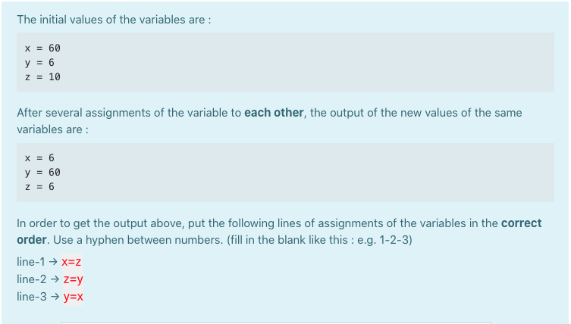
QUESTIONS
Uygulanacak dönüşümün sırasını yazınız

Slide 62
LINUX
Windows Subsystem for Linux Installation Guide for Windows 10
Linux CENTOS 7 online without installing
Linux with Docker Container

